Slide 1
The tutorial to build shared AI services --Session 1
Suqiang Song (Jack)
Director & Chapter Leader of Data/AI Engineering @ Mastercard
jackssqcyy@gmail.com
https://www.linkedin.com/in/suqiang-song-72041716/

Slide 2
Agenda
Session 1: Jan. 30th Wed 10am-12pm PT
Module 1: Case study: AI as a Service (30 mins)
A typical end to end AI Service
Hidden truths of AI
Options of AI as a Service
The journey of AI as a Service
Challenges of traditional machine learning
How deep learning can improve
Enterprise requirements for AI as a Service
Deep learning approaches evaluation
Module 2: Keras on Spark (30 mins)
Keras introduction
Options of Keras on Spark
Use case for user item propensity model
Build a User Item Propensity model with deep learning algorithms
Neural Collaborative Filtering deep learning algorithm
Code Lab 1 (45 mins)
Build a Docker image and run a Keras on Spark container
Run the NCF deep learning pipeline for User Item Propensity model
Q & A (15 mins)

Slide 3
Course Prerequisites
Install Docker at your local laptop
Download two Docker images from shared drive URL keras-py27-jupyter-cpu.tar and demo-whole.tar
passcode : jack
Load images to your Docker environment
https://1drv.ms/f/s!AsXKHMXBWUIBiBpaYk9FFjdoUifg
$ docker load -i keras-py27-jupyter-cpu.tar
$ docker load -i demo-whole.tar

Slide 4
Module 1

Slide 5
A typical end to end AI Service Personalized recommendations Services
Step 3: Business Rules
Offer limits and objectives
Client Data
Target Groups / Variables
Step 1: Data Inputs & Harmonization
Business rules & constraints
Harmonize, link and scale
Independent Variables
Propensity Engine
Data Lake
Customer Preferences
Propensities & Predictions
Optimisation Engine
Third Party Data
Step 4: Optimisation
Step 2: Features & Models
Analysis & Results
Recommendations & Decisions
Execution & Fulfilment
Step 5: Fulfilment & Analysis

Slide 6
Micro services
+ pipelines
Recommendation Services
Real Time
Serving
Streaming
Serving
Batch
Serving
Serving Pipelines
RT, NRT and Batch
ML /DL learning pipelines
Historical + Incremental
Learning Pipelines
ML/DL, His and Incremental
Open APIs
All kinds of Micro service Serving APIs
Metrics
Data Pipeline Bus
Data Pipeline Engine
Data Pipeline Bus
Metrics Pipelines
Model Performance Metrics Monitoring
Data Integration Pipelines
RT, Rule and Batch
Real Time
Event Integration
Business Rule
Integration
Batch
Data Integration
Integration
Endpoints
Message
Bus
Online Systems
CRM
Files
Transfer
Data Lake
Monitoring
Data Sources

Slide 7




Published Recommendation Services (Open APIs )
Shared Serving pipelines
Available Recommendation Services
Shared Serving
Resource Pool
(Repository)
Batch Serving Processors
User Item Scoring
Service 1
APIs Call Flow
User-Items Propensity
Model
User –User Similarity Searching
APIs Compose
Async Return Result
Item-Item Similarity Searching
Interactive
Serving Processors
User-User Ranking
Service n
APIs Call Flow
APIs Compose
User-Items Propensity
Model
Item-Item Ranking
Sync Return Result
…..

Slide 8
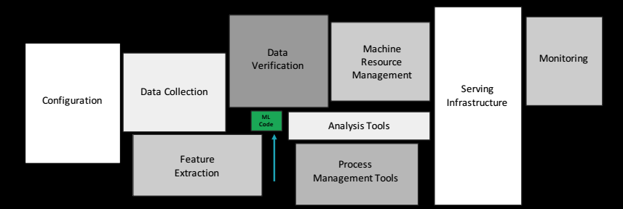
Hidden truths for AI
“Hidden Technical Debt in Machine Learning Systems,” Google NIPS 2015
Figure 1: Only a small fraction of real-world ML systems is composed of the ML code. The required surrounding infrastructure is vast and complex. These include boundary erosion, entanglement, hidden feedback loops, undeclared consumers, data dependencies, configuration
issues, changes in the external world, and a variety of system-level anti-patterns

Slide 9
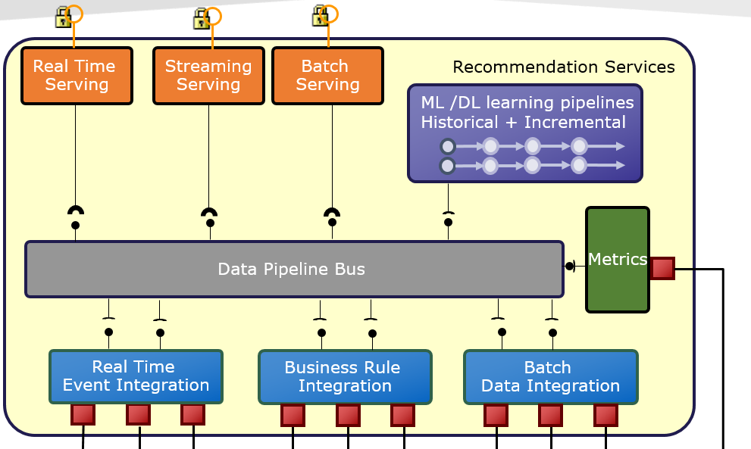




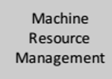
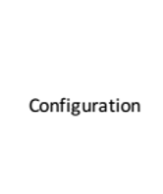




Hidden truths for AI – Where the debts ?

Slide 10
Hidden truths for AI -- continue
A Long and Expense Journey
Configuration
Cost
Process Management Tools
$100,000
Analysis Tools
Machine Resource Management
Serving Infrastructure
Feature Extraction
Monitoring
Model Deployment
&Serving
Data Collection
Ml Code
Data Verification
Evaluation
& Benchmarking
Features
Engineering
Modeling
Data Exploration &
Harmonization
0,0
Time
Months

Slide 11
Options of AI as a Service
AI Applications
AI Applications
AI Applications
Plus
Premium
Regular
Automation
Services
Fully managed
machine learning services
Fully managed
machine learning services
Machine learning frameworks
Machine learning frameworks
Machine learning frameworks
On / Off Premise Advanced Infrastructure
On / Off Premise Advanced Infrastructure
On / Off Premise Advanced Infrastructure
Machine learning frameworks: Provide stable and secure environments and consolidate integrated wrappers on top of variable technologies for regular machine learning works
Applications build silos from scratch
Fully managed machine learning services use templates, pre-built models and drag-and-drop development tools to simplify and expedite the process of using a machine learning framework
Applications share templates and pre-built models , assembly and infer them into pipelines or business context
Automation Services, tasks like exploratory data analysis, pre-processing of data, hyper-parameter tuning, model selection and putting models into production can be automated
“God's Return to God, Satan's Return to Satan , Math’s Return AI, Business’s Return Biz”

Slide 12
Journey 1:Machine learning frameworks
Example : Machine Learning Sandbox
Configuration
Cost
Process Management Tools
$80,000
Analysis Tools
Machine Resource Management
Serving Infrastructure
Feature Extraction
Monitoring
Model Deployment
&Serving
Data Collection
Ml Code
Data Verification
Evaluation
& Benchmarking
Features
Engineering
Modeling
Data Exploration &
Harmonization
0,0
Time
Months

Slide 13
Journey 2: Fully managed machine learning services
Example : Data Science Workbench (Microsoft ML Studio)
Configuration
Cost
Process Management Tools
Analysis Tools
$50,000
Machine Resource Management
Serving Infrastructure
Feature Extraction
Monitoring
Model Deployment
&Serving
Data Collection
Ml Code
Data Verification
Evaluation
& Benchmarking
Features
Engineering
Modeling
Data Exploration &
Harmonization
0,0
Time
Weeks

Slide 14
Journey 3: Automation Services
Example : Netflix , Amazon Sage Maker…
Configuration
Cost
Process Management Tools
Analysis Tools
$10,000
Machine Resource Management
Serving Infrastructure
Feature Extraction
Monitoring
Data Collection
Ml Code
Data Verification
Evaluation
& Benchmarking
Features
Engineering
Modeling
Model Deployment
&Serving
Data Exploration &
Harmonization
0,0
Time
Days

Slide 15
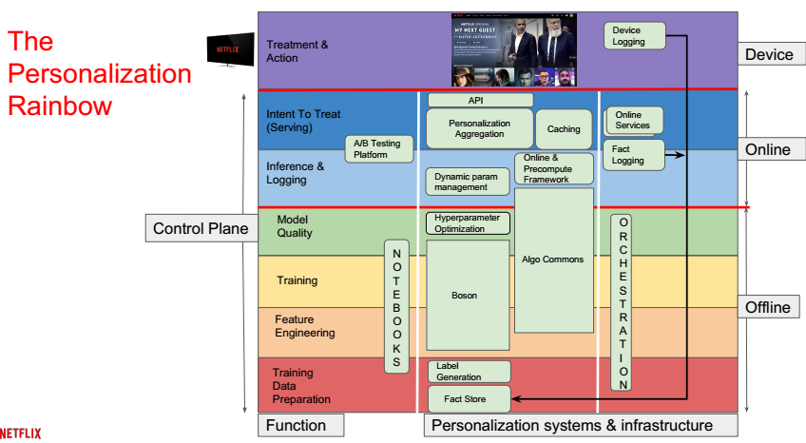
What we can learn from Netflix ?
https://www.slideshare.net/FaisalZakariaSiddiqi/ml-infra-for-netflix-recommendations-ai-nextcon-talk

Slide 16
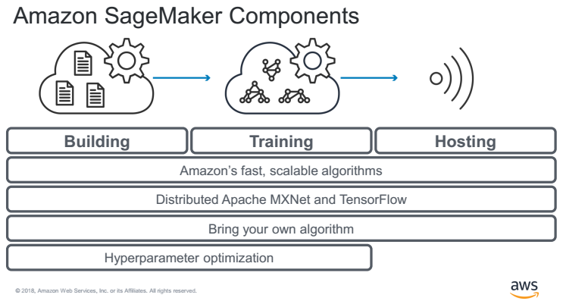
What we can learn from Amazon ?

Slide 17
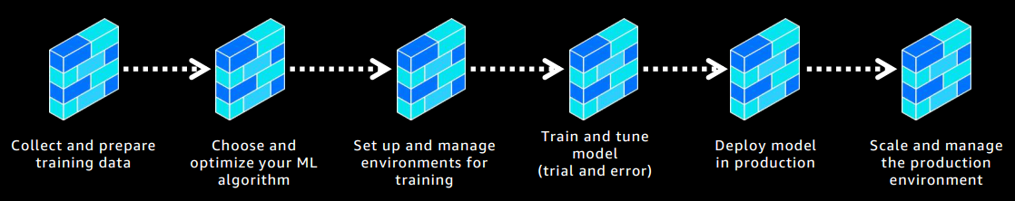
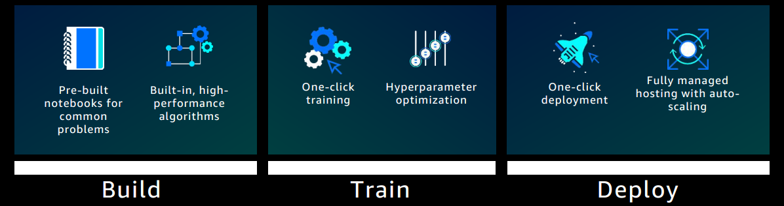
What we can learn from Amazon ? -- Continue

Slide 18
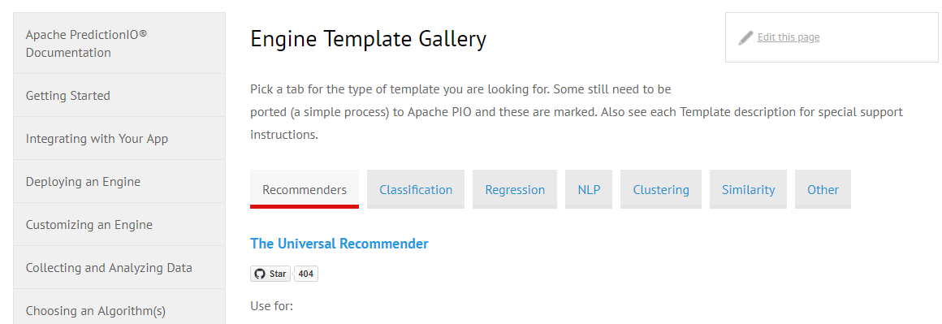
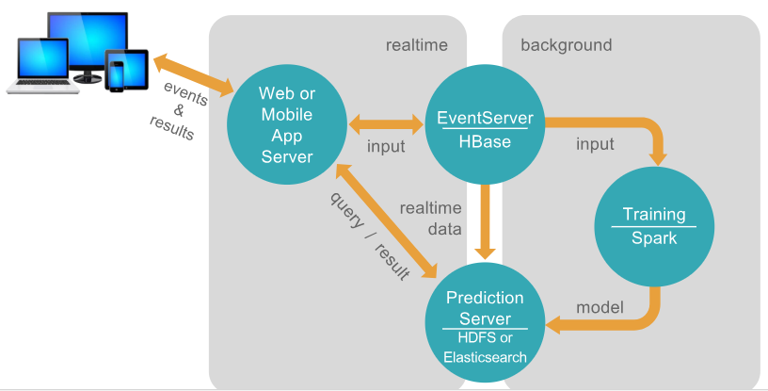
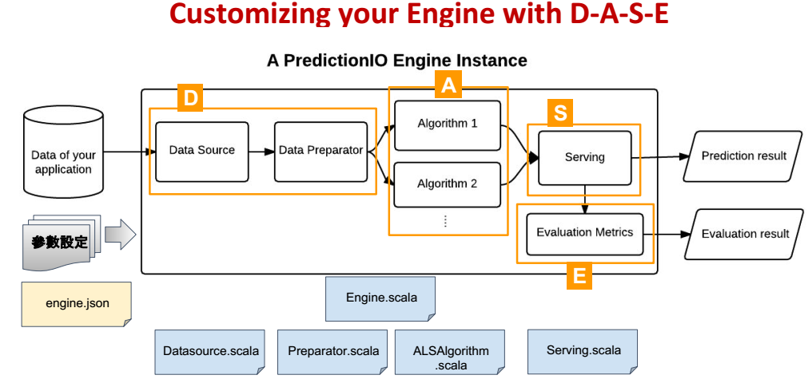
What we can learn from Prediction IO ?
http://predictionio.apache.org/

Slide 19
Challenges of traditional machine learning
Learning
Serving
1
Feature engineering bottlenecks
Pre-calculate hundreds or thousands Long Term Variables take lots of resources and times ( greater than 70%)
4
Less integration with end to end data pipelines and serving multiple contexts
Gap to bring machine learning process into the existing enterprise data pipelines and application contexts including offline, streaming and real-time
2
Model scalability limitations
Trade-off between automation in parallel and scaling machine learning to ever larger datasets and ever more complicated models
5
Isolated non-reusable APIs and CI/CD pipelines
Application teams spent lots of time with data scientist to build high level serving APIs , back and force. Most of time are using different technical stacks and non-reusable pipelines.
Isolated promotions and operation readiness without automate CI/CD
3
Heavily relies on human machine learning experts
Relies on human to perform the most of tasks, such as features selection, model selection, model hyper parameters tuning , critically analyze the results obtained…

Slide 20
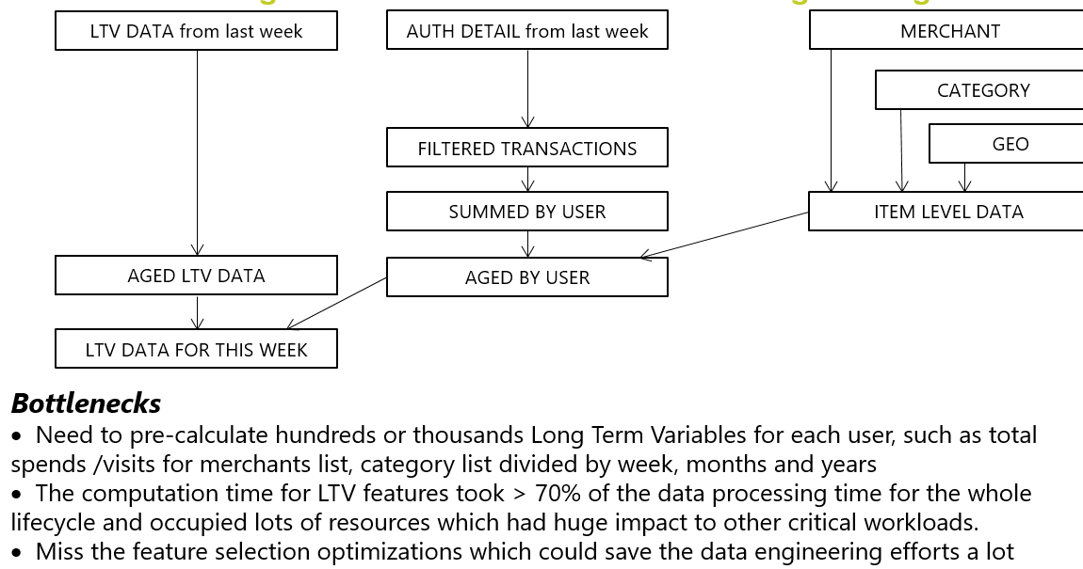
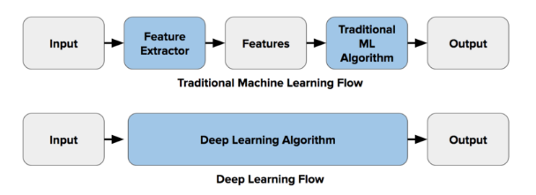
How deep learning can help -- Feature engineering bottlenecks
Improvements
When build model , only focus on few pre-defined sliding features and custom overlap features ( Users only need to identify the columns names from data source)
Remove most of the LTV pre-calculations works, saved hours time and lots of resources
Deep learning algorithm generates exponential growth of hidden embedding features ,do the internal features selections and optimization automatically when it does cross validation at training stage

Slide 21
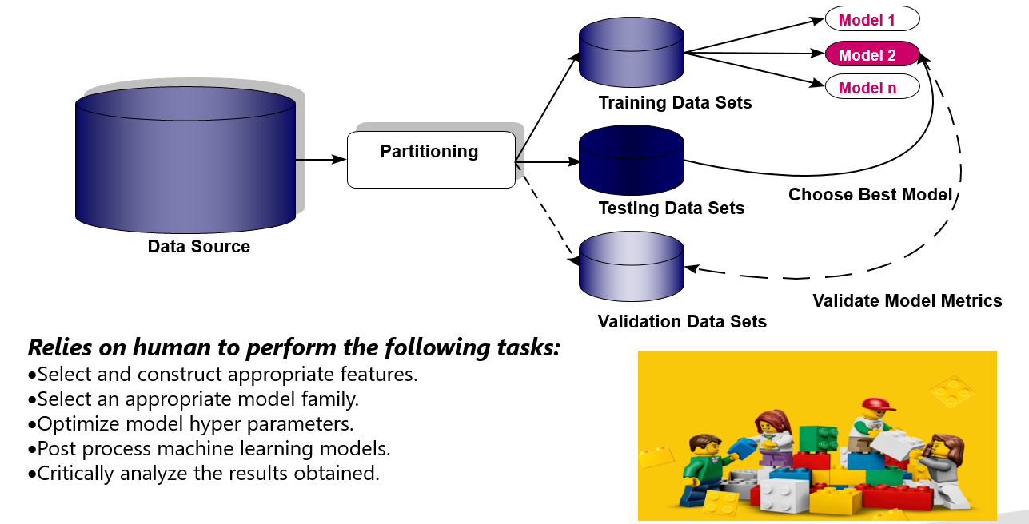
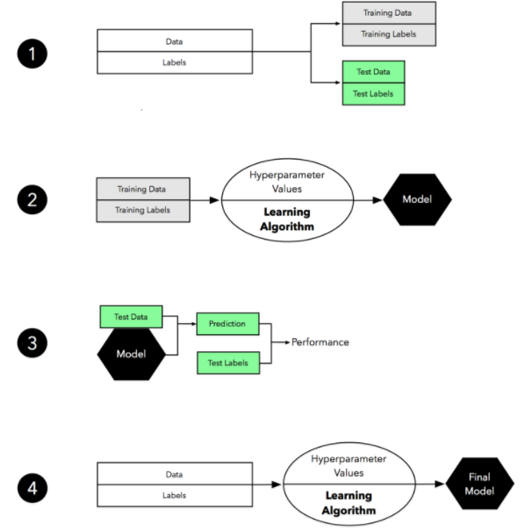
How deep learning can help -- Heavily relies on human machine learning experts
Improvements
Common neural network "tricks", including initialization, L2 and dropout regularization, Batch normalization, gradient checking
A variety of optimization algorithms, such as mini-batch gradient descent, Momentum, RMSprop and Adam
Provides optimization-as-a-service using an ensemble of optimization strategies, allowing practitioners to efficiently optimize models faster and cheaper than standard approaches.

Slide 22
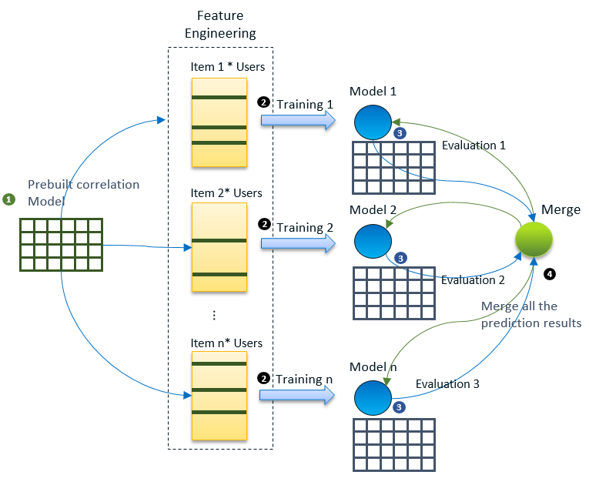
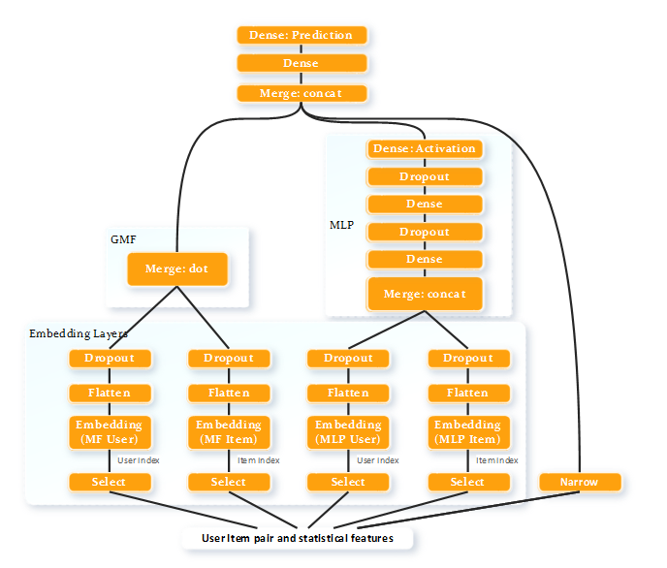
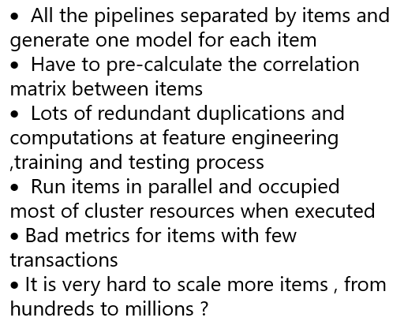
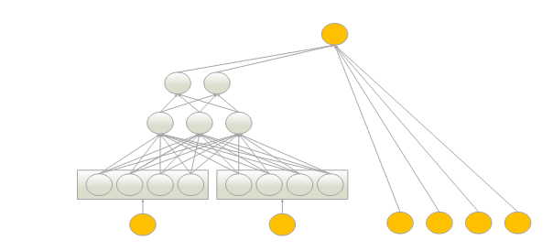
How deep learning can help -- Model scalability
LR
NCF
Wide And Deep
Improvements
Scale models in deeper and wider without decreasing metrics

Slide 23






Enterprise requirements for AI as a Service
Collocated with mass data storage
Analyze a large amount of data on the same Big Data clusters where the data are stored (HDFS, HBase, Hive, etc.) rather than move or duplicate data
Seamless integration with Products Internal & External
Add deep learning capabilities to existing Analytic Applications and/or machine learning workflows rather than rebuild all of them
Shared infrastructure with Multi-tenant isolated resources
Leverage existing Big Data clusters and deep learning workloads should be managed and monitored with other workloads (ETL, data warehouse, traditional ML etc..) rather than run ML/DL workloads standalone in separate clusters
Data governance with restricted Processing
Follow data privacy, regulation and compliance ( such as PCI/PII compliance and GDPR rather than operate data in unsecured zones
Adopt structured sparse data sets
More challenges also more benefits to adopt structured high dimensional sparse data sets rather than non-structured dense data sets
Automation and easy to go
End to end automation rather than manual efforts
Easy API enablement rather than big learning curve or depend on special experts

Slide 24







Deep learning approaches evaluation -- Super Stars
Examples are good for dense high sample size data sets (But won’t help us )
Claimed that the GPU computing are better than CPU which requires new hardware infrastructure (very long timeline normally )
Success requires many engineer-hours ( Impossible to Install a Tensor Flow Cluster at STAGE ...)
Low level APIs with steep learning curve ( Where is your PhD degree ? )
Not well integrated with other enterprise tools and need data movements (couldn't leverage the existing ETL, data warehousing and other analytic relevant data pipelines, technologies and tool sets. And it is also a big challenge to make duplicate data pipelines and data copy to the capacity and performance.)
Tedious and fragile to distribute computations ( less monitoring )
The concerns of Enterprise Maturity and InfoSec ( such as use GPU cluster with Tensor Flow from Google Cloud ) …………..

Slide 25
Module 2

Slide 26
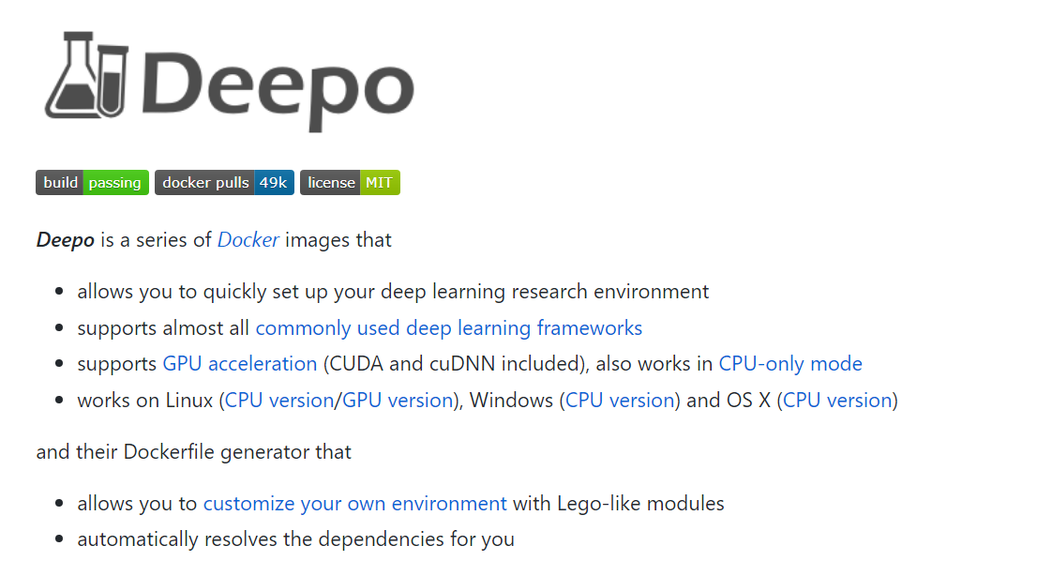
Keras introduction
-- Introduce a simple play ground , not just for Keras
https://github.com/ufoym/deepo

Slide 27
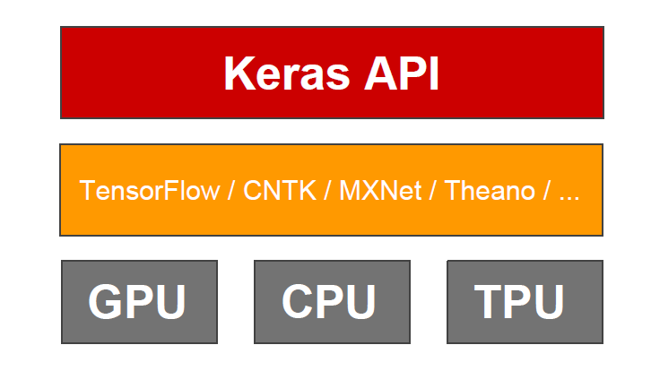
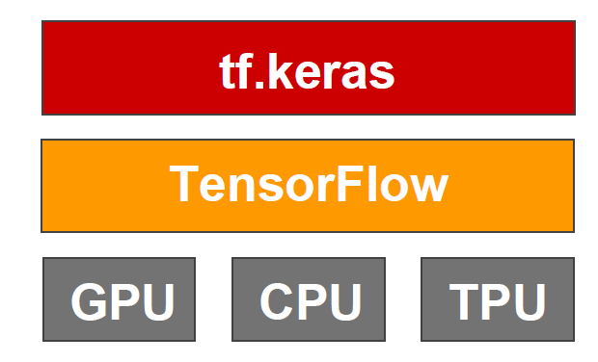
Keras introduction
-- Basic concepts
Keras: an API for specifying & training differentiable programs
Keras is the official high-level API of
TensorFlow

Slide 28
Keras introduction
-- Three API styles
The Sequential Model
- Dead simple
- Only for single-input, single-output, sequential layer stacks
- Good for 70+% of use cases
The functional API
- Like playing with Lego bricks
- Multi-input, multi-output, arbitrary static graph topologies
- Good for 95% of use cases
Model subclassing
- Maximum flexibility
- Larger potential error surface

Slide 29
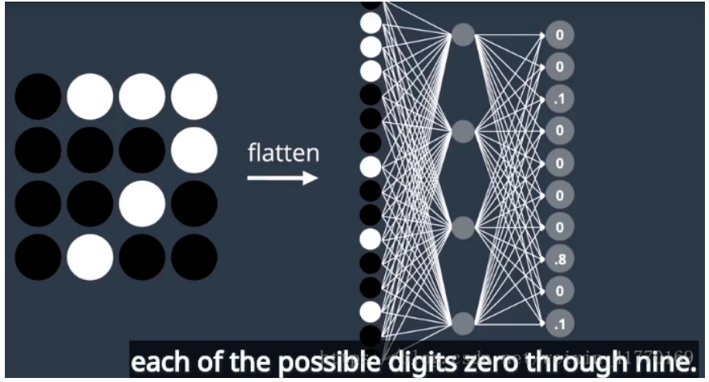
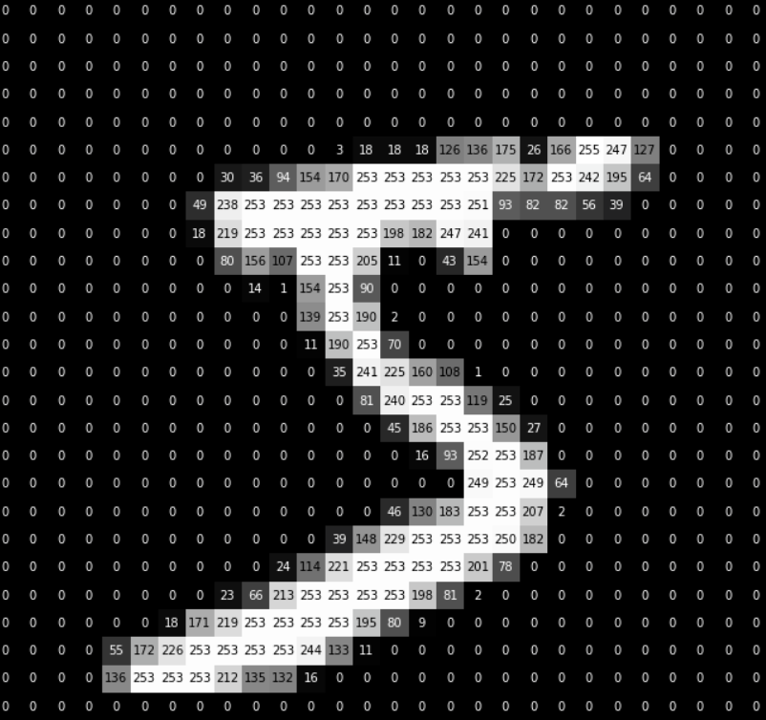
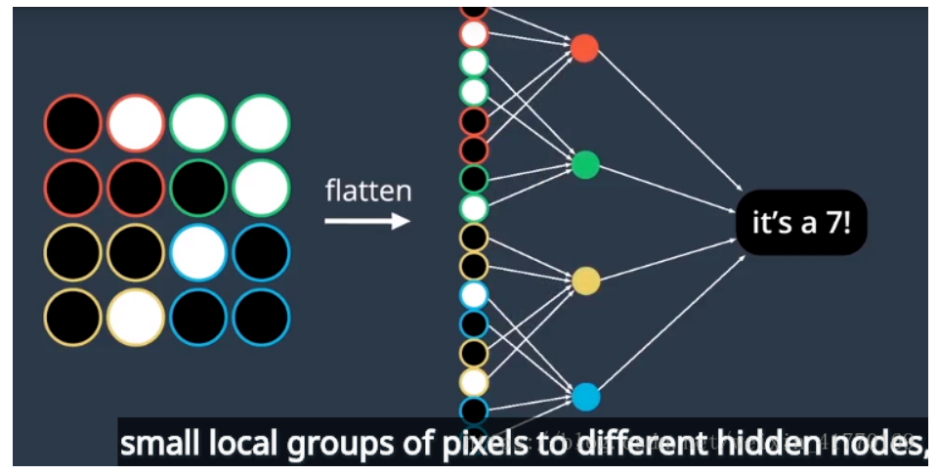
Keras introduction
-- Example for entry : MINST by MLP and CNN

Slide 30
Code time !
$ docker run -it -p 8888:8888 --ipc=host ufoym/deepo:all-py27-jupyter-cpu jupyter notebook --no-browser --ip=0.0.0.0 --allow-root --NotebookApp.token="demo" --notebook-dir='/root'

Slide 31
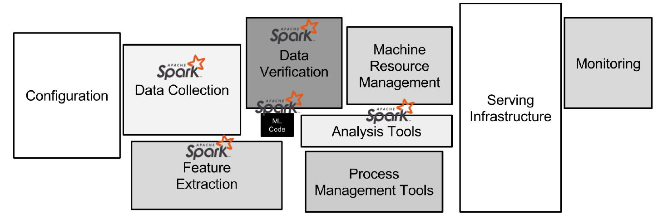
Why Spark ?

Slide 32
What does Spark offer for deep learning ?
Integrations with existing DL libraries
• Deep Learning Pipelines (from Databricks) • Caffe (CaffeOnSpark) • Keras (Elephas) • mxnet • Paddle • TensorFlow (TensorFlow on Spark, TensorFrames) • CNTK (mmlspark)
Implementations of DL on Spark
• BigDL+ Analytic Zoo • DeepDist • DeepLearning4J • SparkCL • SparkNet

Slide 33
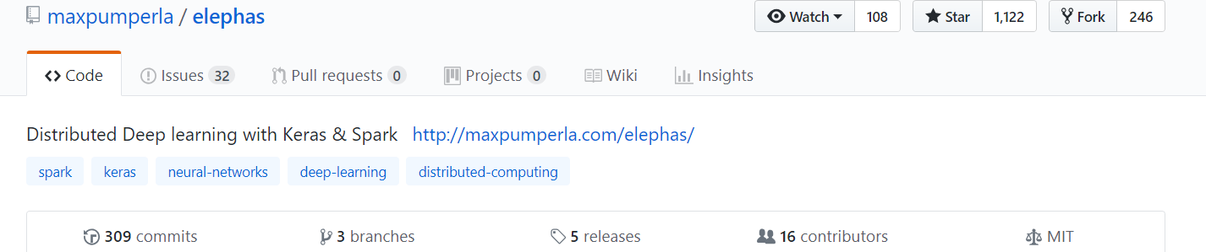
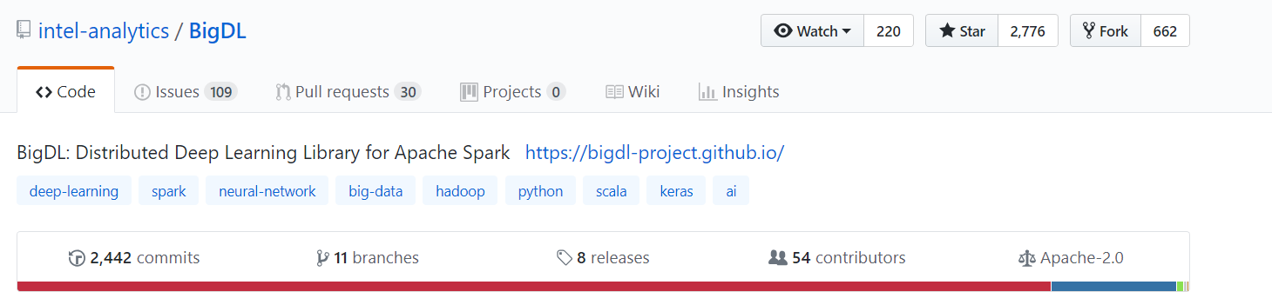
Options of Keras on Spark

Slide 34
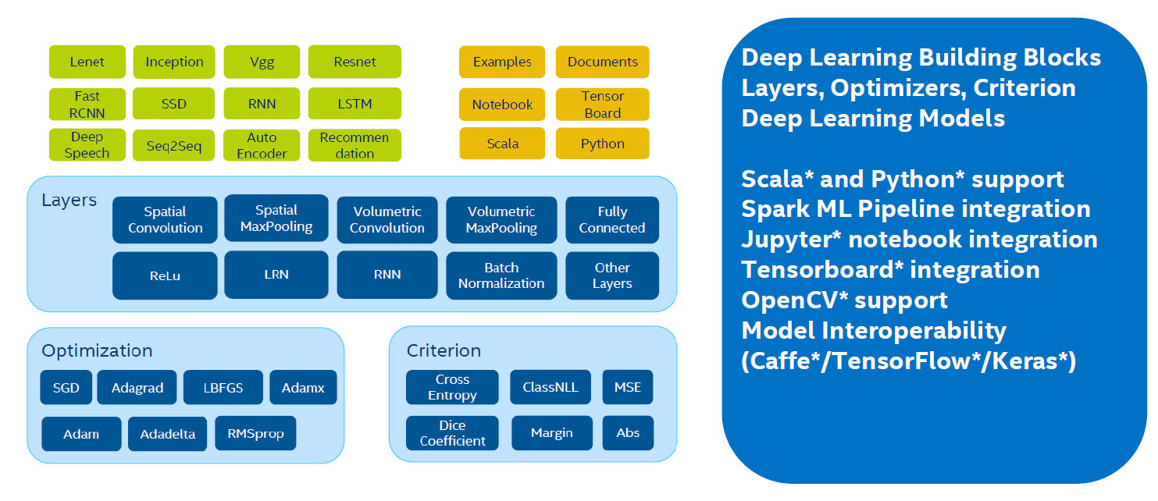
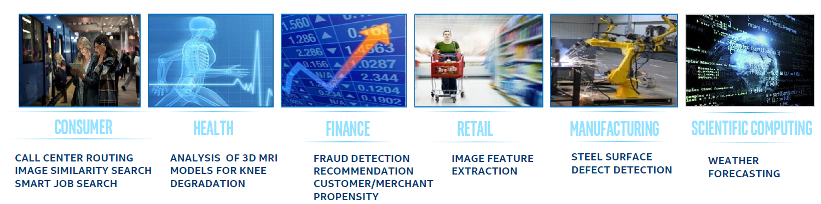
Why BigDL ?

Slide 35
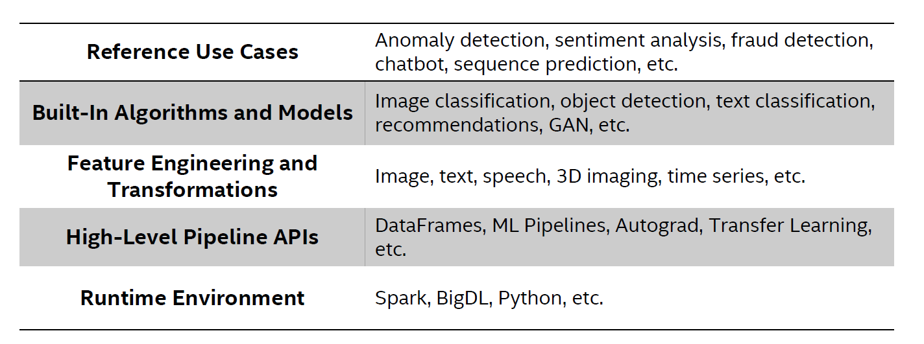
Why Analytics Zoo ?
Analytics Zoo -> Unified Analytics + AI Platform for Spark and BigDL
https://github.com/intel-analytics/analytics-zoo

Slide 36
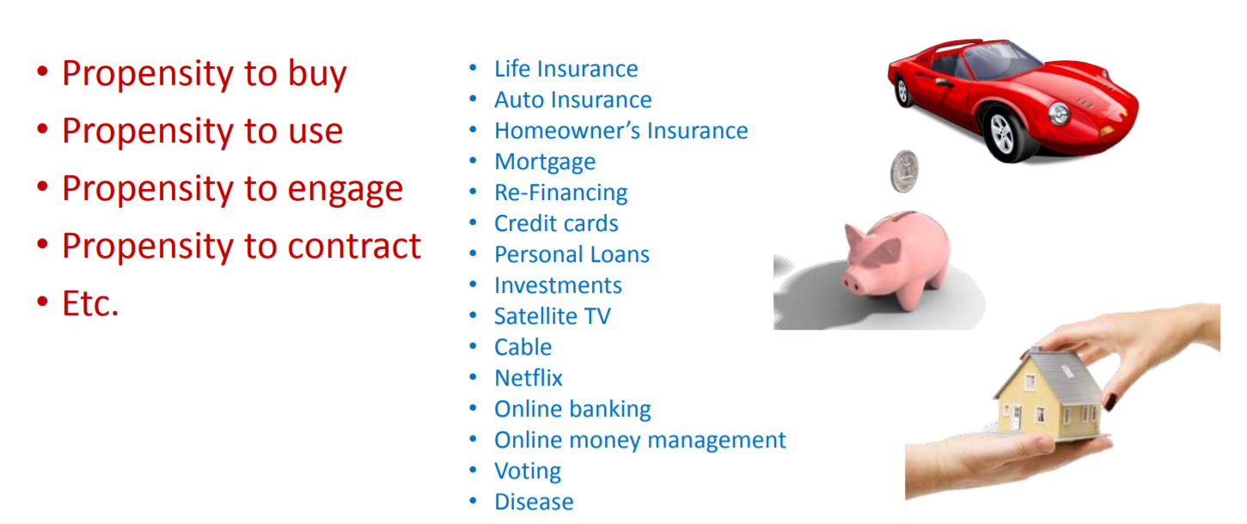
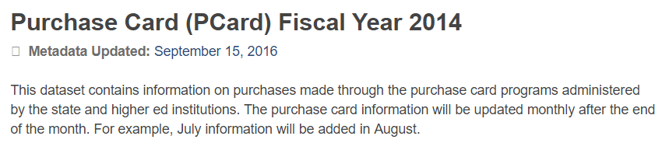
Use case for user item propensity model
https://catalog.data.gov/dataset/purchase-card-pcard-fiscal-year-2014

Slide 37
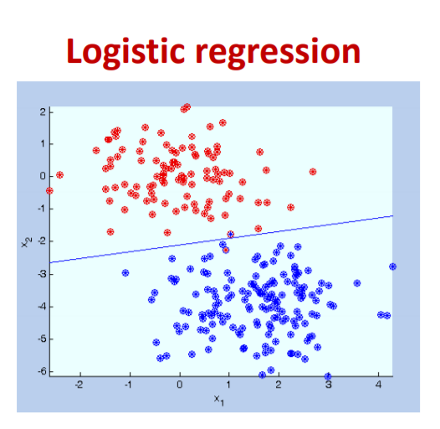
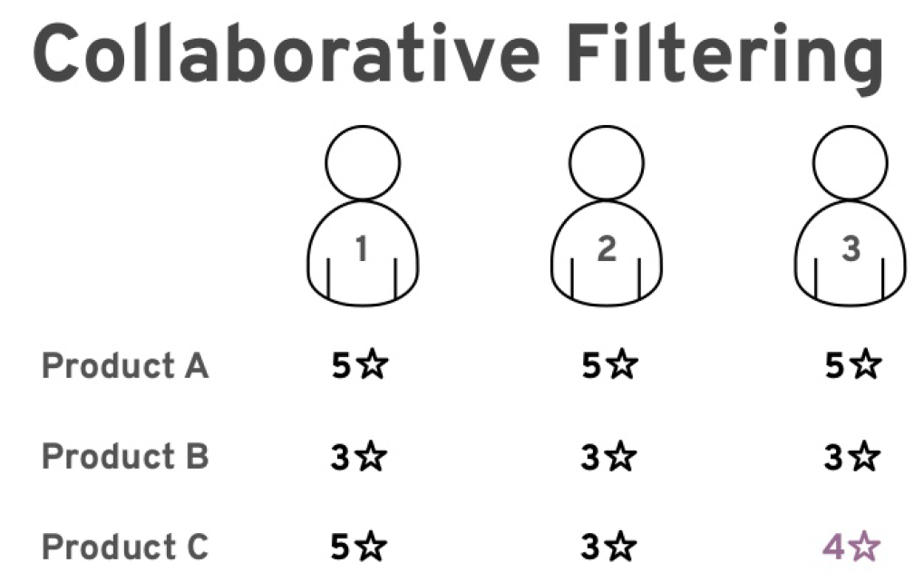
Build a User Item Propensity model with deep learning algorithms

Slide 38
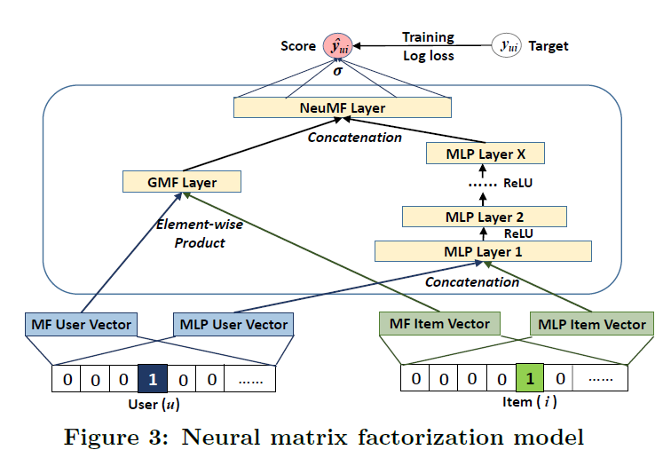
Neural Collaborative Filtering deep learning algorithm
https://arxiv.org/pdf/1708.05031.pdf
https://github.com/hexiangnan/neural_collaborative_filtering

Slide 39
Code Lab 1
$ docker run -it -p 8080:8080 -p 8443:8443 -p 10000:10000 -p 8998:8998 -p 12345:12345 -p 8088:8088 -p 4040:4040 -p 7077:7077 -e NotebookPort=12345 -e NotebookToken="demo" -e RUNTIME_DRIVER_CORES_ENV=1 -e RUNTIME_DRIVER_MEMORY=2g -e RUNTIME_EXECUTOR_CORES=1 -e RUNTIME_EXECUTOR_MEMORY=4g -e RUNTIME_TOTAL_EXECUTOR_CORES=1 --name demo -h demo demo:latest bash

Slide 40
Build a Docker image and run a Keras on Spark container
https://github.com/jack1981/AaaSDemo

Slide 41
Run the NCF deep learning pipeline for User Item Propensity model
https://github.com/jack1981/AaaSDemo

Slide 42
Q & A

